Slide 1



Feb 28, 2023
and
OKH-LOSH

Slide 2
Valueflows is a standard vocabulary
Valueflows describes flows of economic resources of all kinds within distributed economic ecosystems
Its purpose is to enable inter-networking among many different software applications, used by many different kinds of economic formations
Examples are value networks, supply chains, joint ventures, business collaboration networks…. as well as individual cooperatives and other organizations
Valueflows supports
  Exchange/transfer (mutual credit, marketplace, e-commerce, offer/request matching, gift economy, contribution economy, mutual aid, etc.)
  Production/creation (manufacturing, supply chains, distribution, digital and knowledge works, services, etc.)

Slide 3
Valueflows and OKH
VF and OKH are similarly expressed as RDF specifications
VF and OKH are both committed to open knowledge
VF and OKH are complimentary, and have two areas of overlap:
  Most of what is represented by OKH are considered VF economic resources (component designs, parts, software, documentation, etc.)
  The OKH BoM and instructions are roughly equivalent to the VF recipe
Both VF and OKH are being used in the FabCity project, and making use of the first overlap (crawling OKH-LOSH data on the web and saving it as VF economic resources), but not the second (they are saving OKH design information, but not using VF recipes or planning capabilities)

Slide 4
Potential Maker Workflow
(OKH) Designer creates designs and other artifacts (can be collaborative)
(OKH) Designers and makers can discover open designs
(OKH > VF) Recipes can be created from designs and maker doc
(VF) Makers plan to make something using a recipe (can be distributed)
(VF) Makers use the design and maker documentation to create something
(VF) Makers can credit the design (and other contributions)
(VF) Makers might sell the final product
(VF) Makers can reward the designer and other contributors from the income

Slide 5
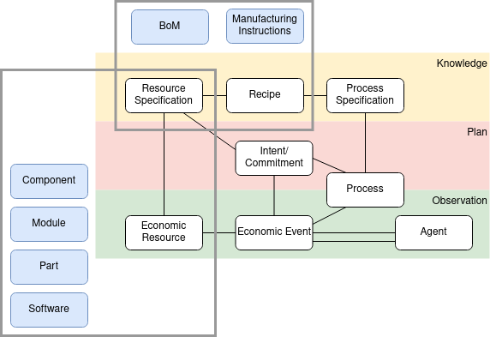
Valueflows and OKH models

Slide 6

VF Recipe: input-process-output
The basic pattern for modeling VF resource
flows is input-process-output. When an
output from one process becomes an input
to another, those processes are connected.
Processes can be defined at whatever level makes sense. For example, they might be
defined at the level of a “step” or “page” in the maker documentation.

Slide 7
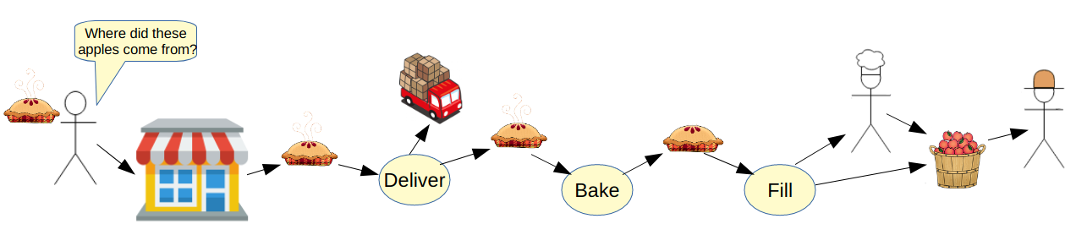
Tracing contributions
This is apple pies, but the same principle would be used for a fabricated item. VF
based software can look backwards through the resource flows and find everything that went into making the item, including the design itself, parts, sub-components,
equipment used, work done by people at each step.

Slide 8
Thank you!
https://valueflo.ws

